Slide 1


The Fine Tuners
14.11.2023
Presented by M.Cem Akuras
Notes:
Hello, as a member of The Fine Tuners I will present Data Understanding and Data Preparation of Tweet2GPT project.

Slide 2

Table of Content
Introduction
01
02
Data Understanding
Data Structure
Column Analysis
Missing Values
Duplicates & Outliers
Data Preparation
03
Launching Data Preparation
ETL Process Enhancements at a Glance
Before and After ETL
04
Summary
Next Steps
05
Notes:
The Table of Content is formed by 5 steps. Which are Introduction, Data Understanding, Data Preparation, Summary and Next Steps.

Slide 3

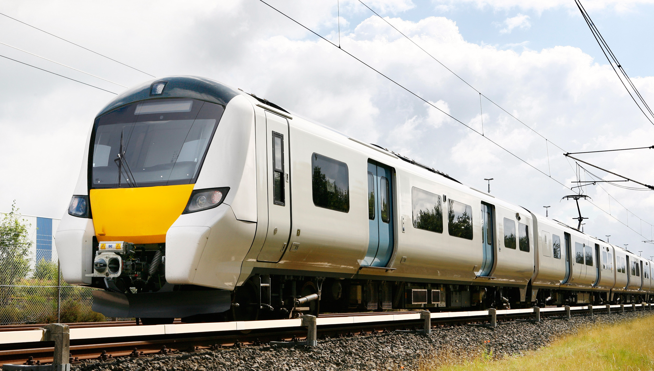
Introduction
Presentation Purpose : Data Understanding and Data Preparation of NLP Analysis Project to improve Train Maintenance.
Data Understanding and Preparation helps to ensure the quality and accuracy of data.
Notes:
As Introduction, this presentation's purpose is examining stages of Data Understanding and Data Preparation for the project, which is focusing on improving Train Maintenance by NLP Analysis of Social Media Tweets
Data Understanding and Preparation helps us to ensure the quality and accuracy of data. This is important for making the right decisions and improving train maintenance.

Slide 4







Data Understanding Data Structure
Data Sources
Data Format
2 different sources
JSON File
Data Quality
Data Size
2,219 Duplicates
3 columns have missing values
16,949 Rows
20 Columns
Data
Data Types
1 Date/Time
4 Categorical
8 Numeric,
1 String
6 Constant
Flat File
Data Organisation
Notes:
This slide gives brief information about how is Data Structured.
The Data is in JSON format and has 16.949 Rows and 20 Columns where it has 2219 duplicated rows and 3 columns with missing values.

Slide 5
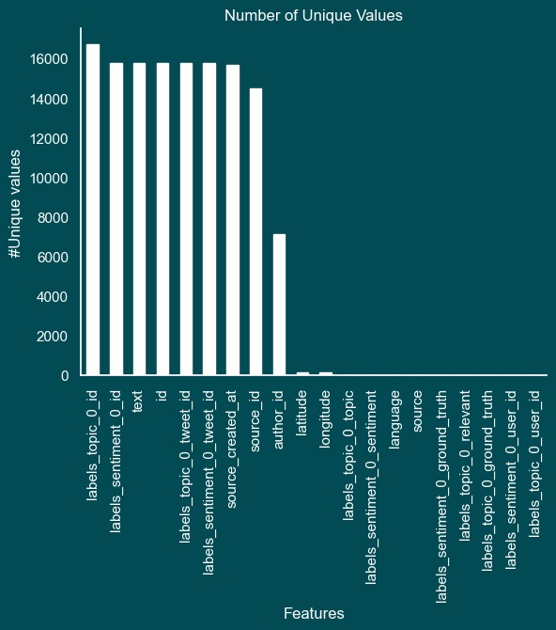
Data Understanding Column Analysis
16,949 tweets provides a substantial volume for the analysis.
Columns including text, timestamps, and other relevant information.
Columns with star are ‘text’, ‘author_id’, ‘labels_sentiment_0_topic’, ‘source_created_at’, ‘labels_topic_0_topic’ and ‘source’.
Notes:
Here Column Analysis comes.
There are around 17000 tweets in the text column of the dataset and they provide a significant volume for analysis.
The dataset includes 20 columns and various data types.
However, 6 of them are chosen with the aim of identifying the most relevant variables for our analysis and model.
These 6 columns are signed with stars over the Number of Unique Values graph.
These 6 columns are chosen because they provide valuable insights for our project.

Slide 6
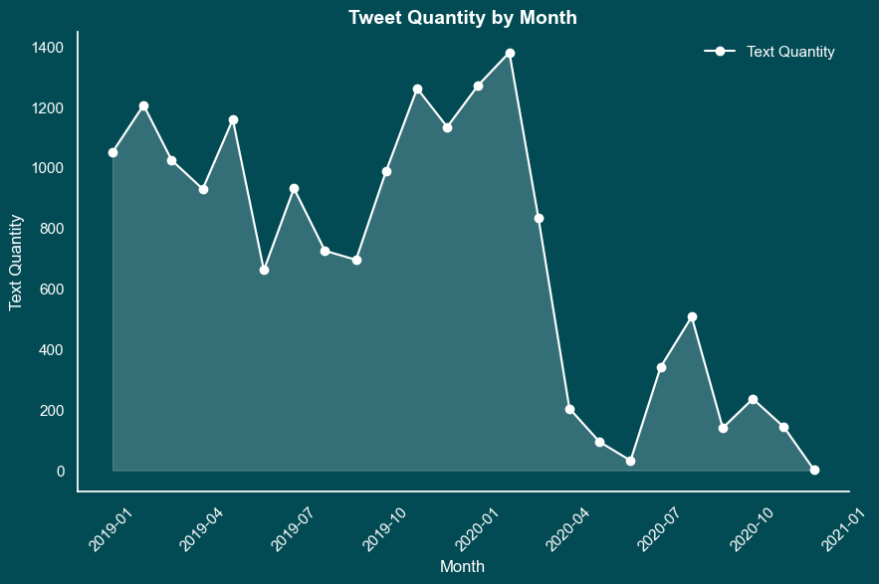
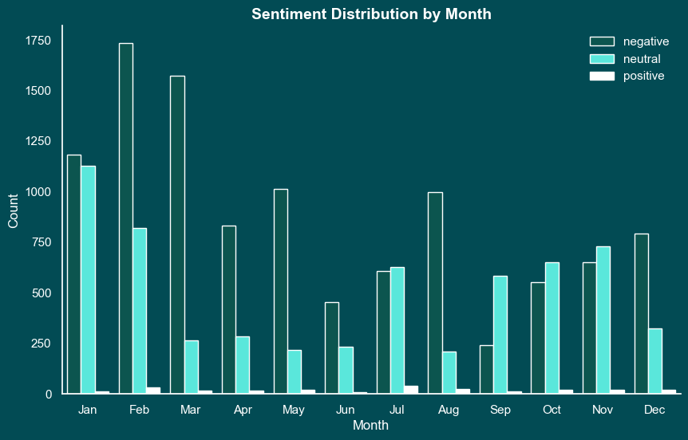
Data Understanding Time
The dataset covers a time interval from the beginning of 2019 to the end of 2020.
The graph shows how sentiments evolved month by month alongside tweet quantity.
Notes:
As seen in the first graph the dataset covers a time range from the beginning of 2019 to the end of 2020.
In addition, sentiment distribution was also examined month by month. Second graph shares information about how sentiments evolved within the dataset over the same time range.
Data collection took place over twelve months of the year and all sentiments are included in each month. This minimises potential seasonal biases.

Slide 7
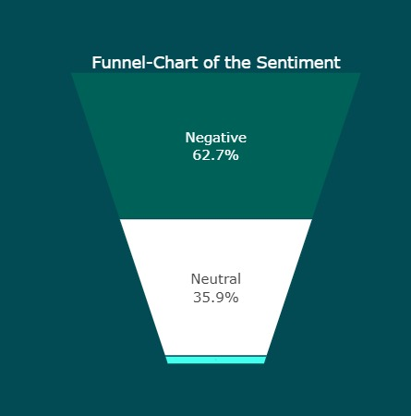
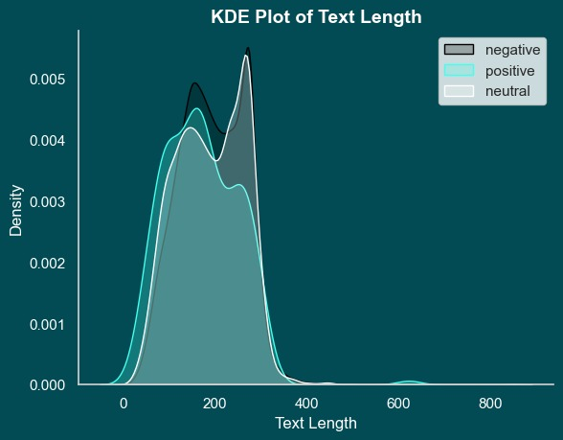
Data Understanding Sentiment
The dataset's 'Sentiment' column classifies tweets into negative, positive, or neutral sentiments.
There exist a trend where negative sentiments align with longer text posts.
Positive
Notes:
The dataset includes sentiment annotations in the form of a 'Sentiment' column. Sentiments are categorised into negative, positive, and neutral way.
In our analysis, we found that negative sentiments overlapped with longer texts.
This shows that people shows their anger, disappointment or negative feelings with longer and more detailed tweets.

Slide 8
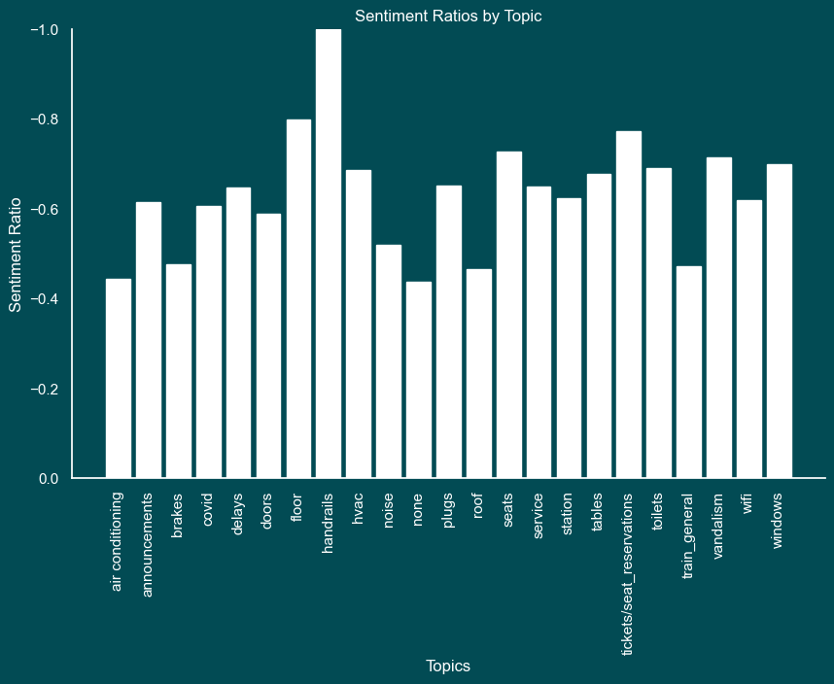
Data Understanding Sentiment
Chart shows average sentiment on various topics and provides insight into sentiment differences by topic.
Notes:
This graph presents the average sentiments (positive, negative, and neutral) for all topics of the dataset. It shows how sentiment varies across different topics.
For example, all tweets about handrails are written with negative sentiments, but negative sentiments do not carry that much weight on the roof topic.

Slide 9
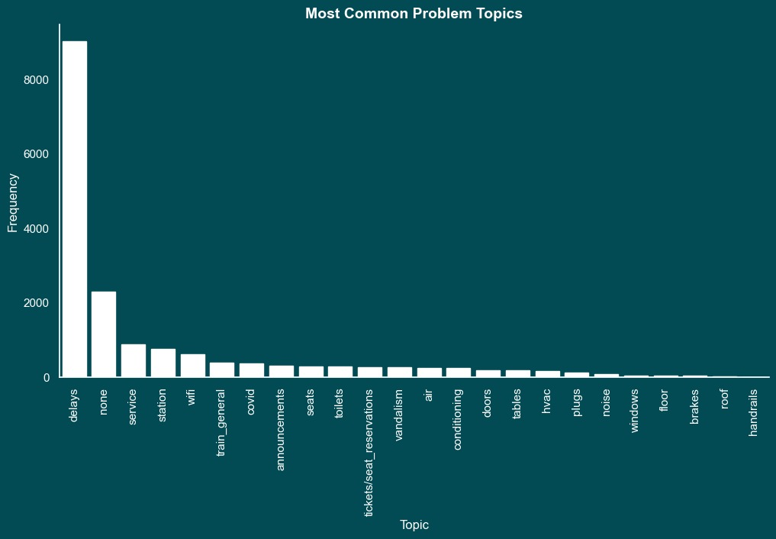
Data Understanding Topic
The dataset includes tweet topic annotations for classification and analysis.
Notes:
The dataset includes categorical annotations for tweet topics. It helps to classify tweets based on their subjects.
And as seen, most of tweets are written about delays.

Slide 10
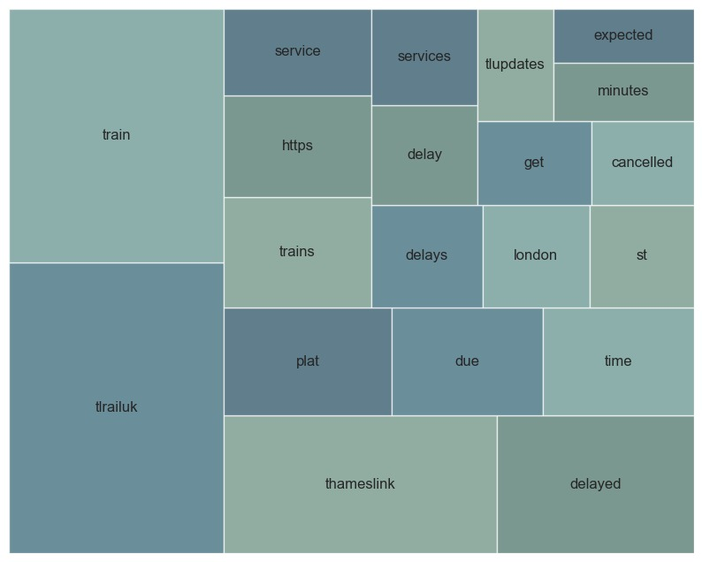
Data Understanding Text
Frequently used words visualization highlights dominant terms in tweets.
Graph includes variations of the most common topic "delay": "delay", "delays", and "delayed".
Notes:
When we said Delay, our analysis also includes visualisation of the most frequently used words in the dataset. This chart provides information about the main topics included in social media tweets.
Most common topic which is 'delay’, appears on this graph in three different ways as 'delay’, 'delays’ and 'delayed’.
We will address this issue during the data preparation process to provide an accurate analysis.

Slide 11
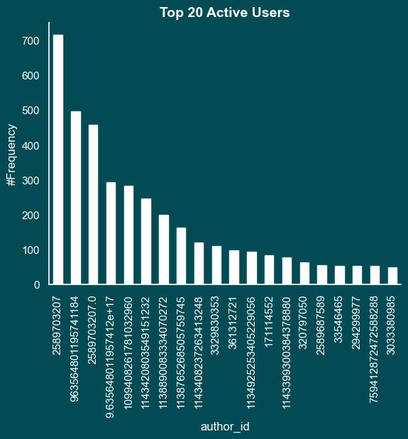
Data Understanding Author ID
The chart shows the top 20 active users. Stars indicate accounts that posted similar tweets that serve as communications for the company.
Notes:
This graph shows top 20 active users.
Users marked with yellow stars use the hashtag #TLUpdates, while users marked with red stars frequently use the hashtag #ThameslinkUpdate.
These accounts share official updates from the company.
As first step of our Project Architecture, we separated the tweets with asking Does Thameslink Send These Tweets? And continued with tweets which gave No answer.

Slide 12
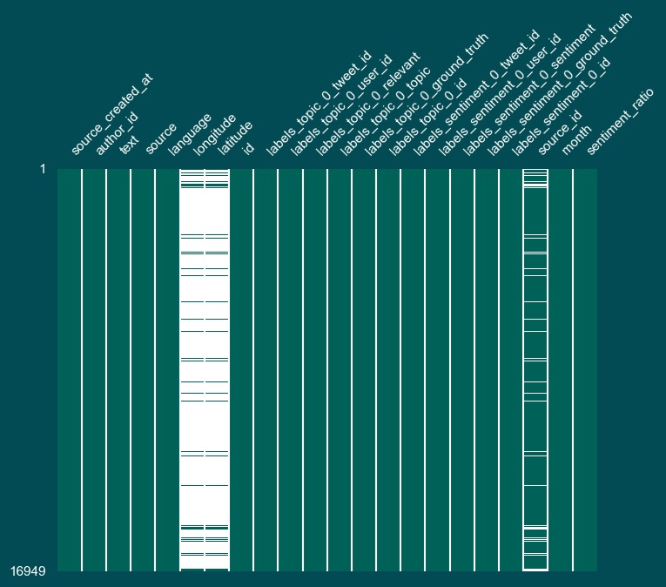
Data Understanding Missing Values
Missing values were identified in three columns in the dataset.
Two columns do not provide actionable information.
Notes:
Missing values were identified in three columns in the dataset. These are Longitude, Latitude and Source ID.
These missing values are in a high ratio in the Longitude and Latitude columns.

Slide 13
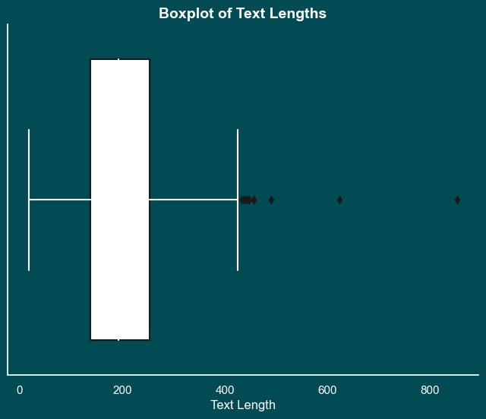


Data Understanding Duplicates & Outliers
2,219 duplicate entries and 37 retweets are identified. Identifying and addressing these duplicates is crucial to ensure the integrity of our analysis and insights.
The box plot highlights 11 outliers in text length within our dataset, with a maximum value of over 800.
11 outliers in text length
2,219 duplicates
37 retweet
Notes:
2,219 duplicate entries and 37 retweets are identified.
Detecting these duplicates is essential to ensure the accuracy and reliability of the analysis.
Also, the box plot highlights 11 outliers in text length, with a maximum value of over 800.

Slide 14
Data Preparation Launching Data Preparation
The entire dataset was used without limiting it to a specific time period, region, or subset.
The dataset will not be split and a pre-trained model will be used.
Use of the Twitter API for additional datasets is under evaluation.
Notes:
To examine all data in detail, the whole dataset was used, without limiting the analysis to a specific time period, region, or subset.
Our team decided not to split the dataset and selected to use an already trained model for evaluation.
Also, our team is currently in the evaluation stage about the potential use of the Twitter API as an additional datasets.

Slide 15
Data Preparation ETL Process Enhancements at a Glance
Findings/Problems | Decision | Impact
Unreadable Column Names | Shorten and Standardize | Improved Data Clarity
Data Types | Fixed Data Types | Enhanced Data Consistency
Redundant Time Information | Remove Second and Millisecond Information | Reduced Data Volume and Improved Data Quality
Singleton and Junk Columns | Removed 14 Columns | Simplified Data Structure and Reduced Data Redundancy
Notes:
This table is giving a brief information about how the ETL Process is Enhanced.
At first there were Unreadable Column Names. It is decided to Shorten and Standardize them to Improve the data clarity.
Data Types were fixed for enhanced data consistency.
At Time information, seconds and millisecond were removed to improve data quality.
14 Singleton and Junk columns were removed to simplify data structure.

Slide 16
Data Preparation ETL Process Enhancements at a Glance
Findings/Problems | Decision | Impact
Duplicate Rows Based on Text Column | Removed 2,219 Rows | Enhanced Data Relevance for Maintenance Improvements
Tweets Sent by Thameslink Accounts | Removed 9 Authors | Enhanced Data Purity and Content Relevance
Delay Related Topics | Removed 7,645 Rows (64% of Data) | Reduced Noise and Enhanced Data Relevance
Notes:
2219 duplicated rows were removed to enhance data relevance.
Tweets from Thameslink accounts are removed as our first step of Project Architecture.
7645 Delay and None topics are removed for enhanced data relevance.

Slide 17

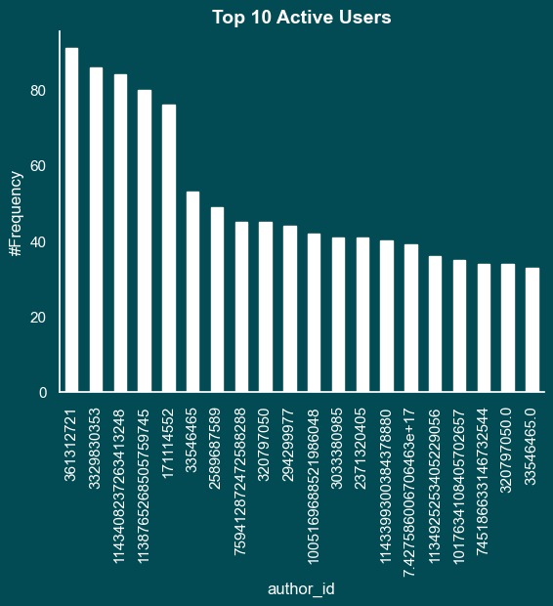
Data Preparation Before and After ETL
Notes:
So we came to Before and After ETL process.
It is said that there were Thameslink related accounts.
The first graph is sharing the distribution before the ETL process, including all accounts, while the second graph is showing the cleaned distribution after removing the 9 Thameslink-related accounts.

Slide 18
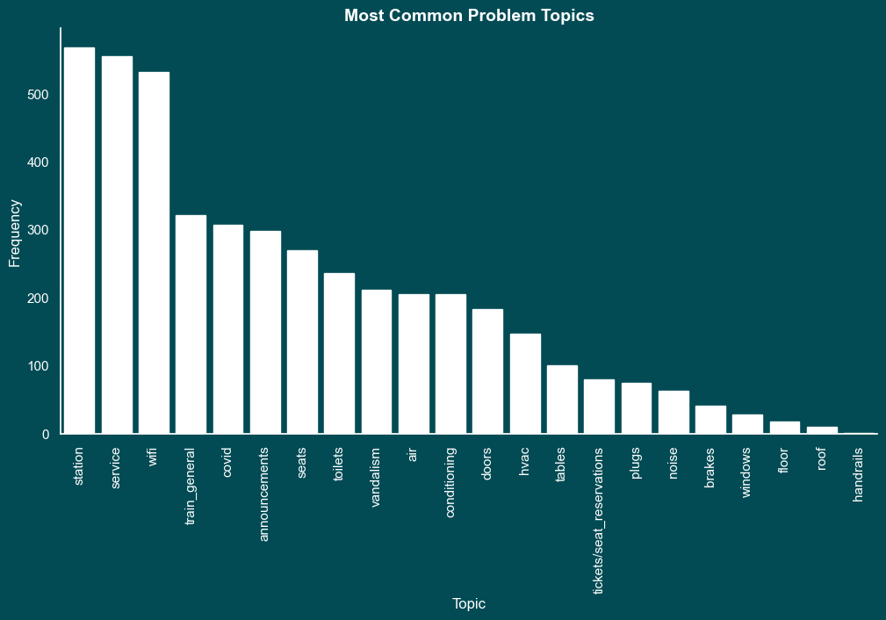
Data Preparation Before and After ETL
Notes:
In our data preparation part, delay related topic is removed because the tweets on delay topics is not offering useful feedback for the maintenance team. It is clear that delays are not welcomed by passengers, but it does not give us the kind of information that could help improve maintenance work.
Therefore, second graph is created to share how topics are changing when delay column is removed from the graph.

Slide 19
Summary
Described the data structure and checked for annotations.
Assessed data quantity, distributions, representation.
Usage of complete dataset .
Handled missing values.
Identified outliers.
Clarified decisions.
Notes:
In summary,
We described the data structure and checked for annotations.
We evaluated data quantity, distributions, representation, and addressed any gaps.
We chose to use the whole dataset for analysis and searched the availability of additional data to improve the analysis.
We handled missing values in the dataset.
Identified outliers from the data.
We clarified the logic behind the decisions made in data preparation and analysis.

Slide 20

Next Steps
Removing tweets with positive sentiment.
Data quality survey.
Take a pretrained classification model and finetune to get the complaints and non-complaints.
Feed the tweets to ChatGPT or any LLM model to get actions to fix the issue.
Notes:
Tweets with positive sentiment will be removed.
Data quality is being checked by a survey which is controlling if tweet has a complaint and which type of complaint is it.
A pretrained classification model will be taken and finetuned to get the complaints and non-complaints.
ChatGPT or any LLM model will be feed with tweets to get the actions to fix the issue.

Slide 21
Thank you!

